Slide 1
Into the Weeds
Session 2

Slide 2
Session 1 Assignment Review

Slide 3
Final Project Questions?
Drop Dead Date:
Mid May!!

Slide 4
Learning Objectives
Understand the Public Domain, Copyright and Fair Use.
Learn how to use a Creative Commons License.
Find OER.

Slide 5
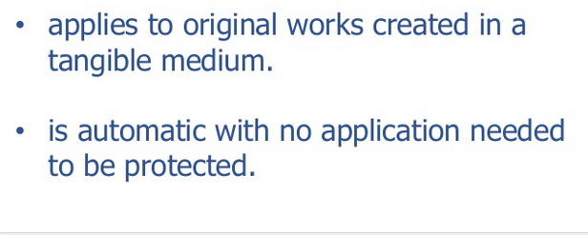
Copyright

Slide 6
© ALL rights reserved
the right to reproduce the copyrighted work
the right to prepare derivative works based upon the work
the right to distribute copies of the work to the public
the right to perform the copyrighted work publicly
the right to display the copyrighted work publicly

Slide 7

Copyright forever

Slide 8
Classroom exemptions
Allows performance or display of works in non-profit, face-to-face, in-person, classrooms or similar instructional settings.

Slide 9
Author Rights & Academic Freedom

Slide 10
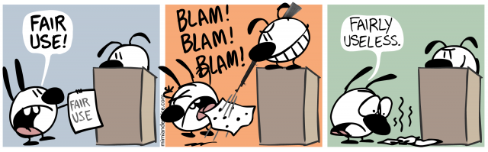
Exploring Fair Use
♡ 2019 Mimi and Eunice. Copying is an act of love. Please copy and share.

Slide 11


Slide 12
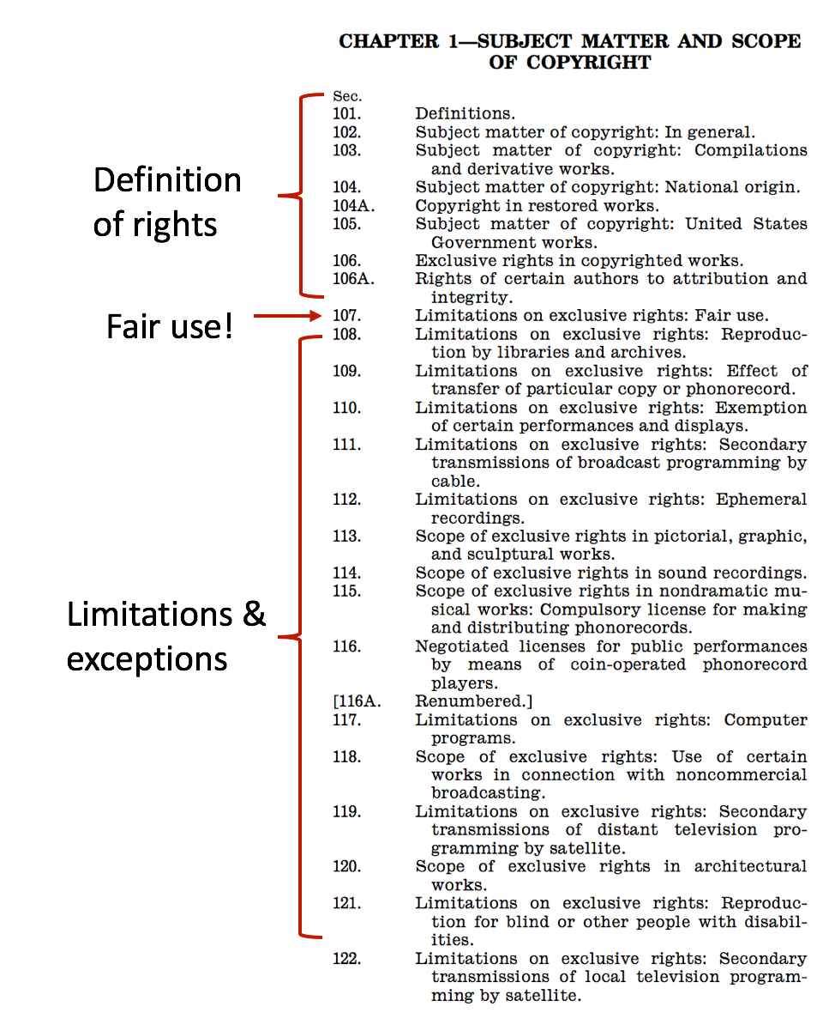
Your Rights

Slide 13
Common Myths
If you’re not making money off of it, it is OK.
A commercial use in not OK.
A specific number of seconds/pages is always Fair Use
If you ask and are denied permission, you can’t use it. Or if you don’t ask for permission, you’ve acted in bad faith.

Slide 14

Dancing Babies & Fair use
https://youtu.be/N1KfJHFWlhQ
Court states explicitly that “Fair use is not just excused by the law, it is wholly authorized by the law.”

Slide 15
Economic Impact of Fair Use
Report: fair use adds $2.2 trillion to US economy each year.
Ars Technica. Anderson, N. (2007, September 13). https://arstechnica.com/uncategorized/2007/09/the-value-of-fair-use-to-the-us-economy-4-5-trillion-a-year/

Slide 16
Rule of Thumb
“Use fairly. Not to much. Have reasons.”
Ask yourself: What is the pedagogical purpose of this item? How will it be used?

Slide 17
Group Activity

Slide 18
Copyright Term and the Public Domain in the United States
https://copyright.cornell.edu/publicdomain

Slide 19
Federal Documents
Public Domain = OER

Slide 20
Open Educational Resources
“Open Educational Resources (OER) are teaching, learning and research materials in any medium that reside in the public domain or have been released under an open license that permits no-cost access, use, adaptation and redistribution by others.”
UNESCO, adapted by Creative Commons
Notes:
For more detail, see https://creativecommons.org/about/program-areas/education-oer/

Slide 21
The 5R Activities
(You need permission to do these 5 things for an ER to be an OER)
Retain | make, own, and control a copy of the resource
Reuse | use the resource for any purpose
Revise | alter, adapt, change, edit, improve, or translate the resource
Remix | combine the resource with other resources to create something new
Redistribute | share the original, revised, or remixed version of the resource with others
Notes:
For more detail, see http://opencontent.org/definition/
The 5Rs are shorthand way of remembering the activities a license must permit you to engage in with regard to an educational resource for that resource to be properly considered an Open Educational Resource (OER)

Slide 22
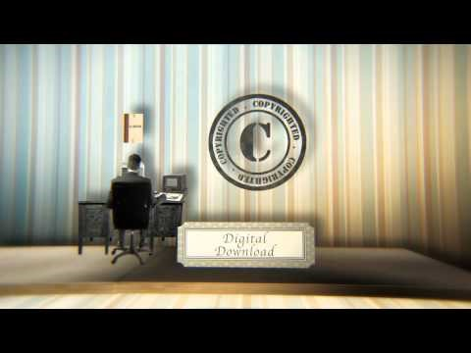
Why Open Education Redux

Slide 23
Creative Commons, the 5Rs, and OER
David Wiley, Lumen Learning
This presentation is licensed CC BY
The Shortest Possible Introduction
Notes:
Thanks to Diane Peters and Cable Green (CC General Counsel and CC Director of Open Education) for their review and comments.

Slide 24
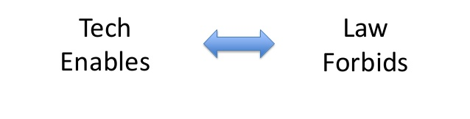
Our problem
Slide 29 CC BY David Wiley

Slide 25
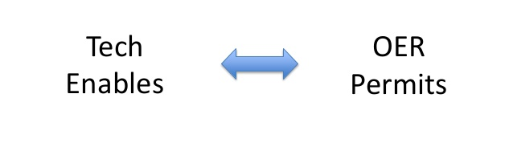

Slide 26
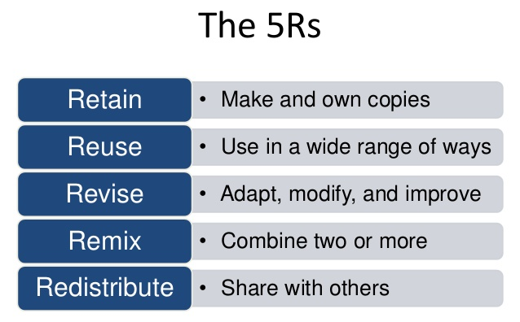
Slide 39 CC BY David Wiley

Slide 27
Creative Commons Licenses
Provide a super easy mechanism for a copyright holder to:
(1) provide everyone in the world with permission to engage in a specific set of (otherwise prohibited) activities,
(2) given that they abide by specific conditions.

Slide 28
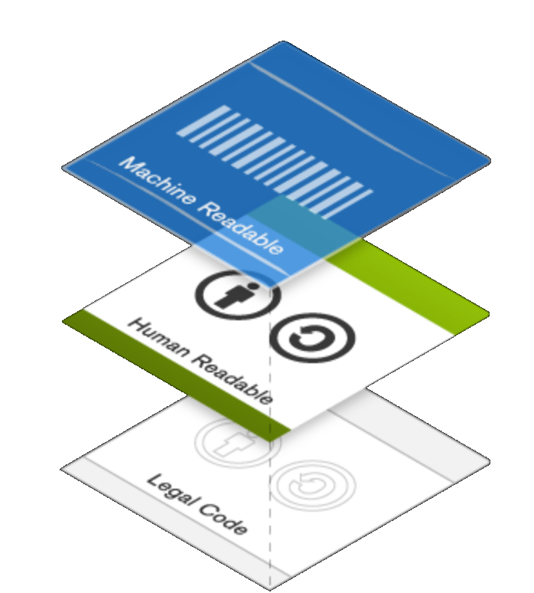
CC Licenses - Layered

Slide 29

CC License Conditions - Attribution
When exercising any of your rights under a CC license, you are required to provide attribution to anyone designated by the licensor (could be one or more creators, organizations, etc.)
This condition, shortened to “BY”, is present in all six Creative Commons licenses.
Notes:
For more detail, see Section 3.a here - https://creativecommons.org/licenses/by/4.0/legalcode

Slide 30
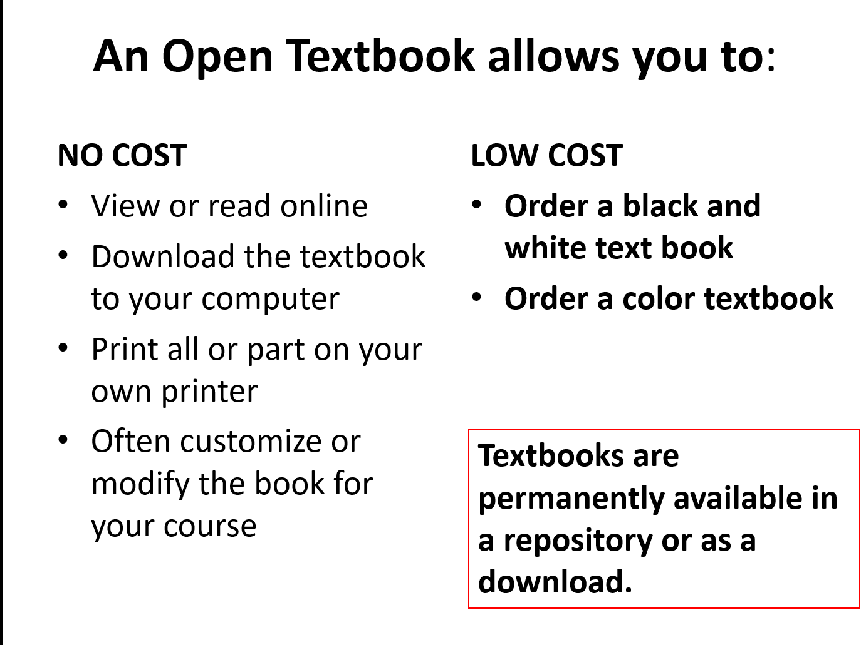

Slide 31
Activity
EXPLORE THE OPEN TEXTBOOK LIBRARY
Reviews
Formats

Slide 32
Activity 2
Explore SUNY OASIS*
OR
Canvas Commons

Slide 33
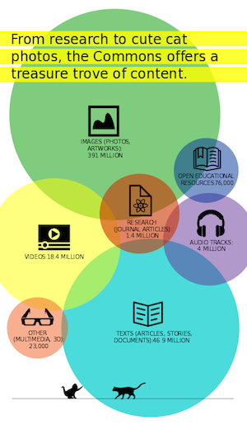
Develop a Search Strategy
You can find OER by using the search engines you already use, or by searching or browsing any of the OER repositories listed.
If you have ever searched for anything online, you know that how you formulate your question, or put in keywords, will reflect in your search results.
Created by Kerrie Wilkes and Phylise Banner on behalf of SUNY OER Services and is licensed under a Creative Commons Attribution 4.0 International License.

Slide 34

Activity 3
Explore OneSearch

Slide 35
Additional Reccomendations
BC Campus
OpenOregon
OER Commons

Slide 36
Where is the license?
In the sidebar or footer of a webpage
Alternatively, look for “terms of use” or a “licensing” page on the website
On the inside front cover of a publication (online or print)
On the back page of a publication (online or print)

Slide 37
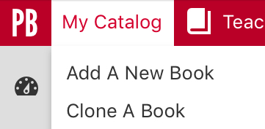
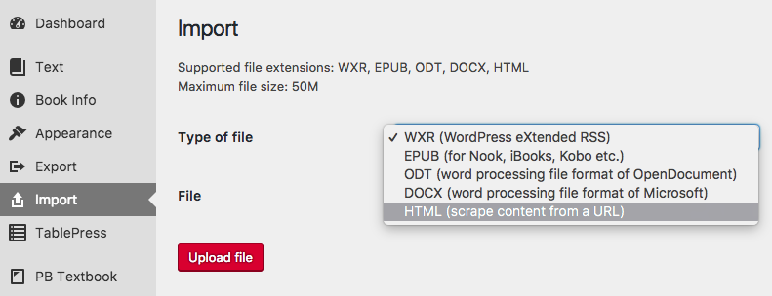

Slide 38
All rights Reserved ©
Applied automatically
Copyright symbol not required
Open Licenses
Vary widely but most permit
Reuse
Redistribution
Examples
Creative Commons CC-BY
GNU Free Documentation License
Public Domain
No restrictions whatsoever
Examples
Pre-1924 material
Federal Gov material

Slide 39
OER Attribution Exercise
Find an OER image.
Write an attribution statement for it.
Send it to me in an email.
Challenge points:
Find a government image and attribute it correctly.

Slide 40
This is not legal advice.
But I’m happy to give you information!

Slide 41
